Slide 1
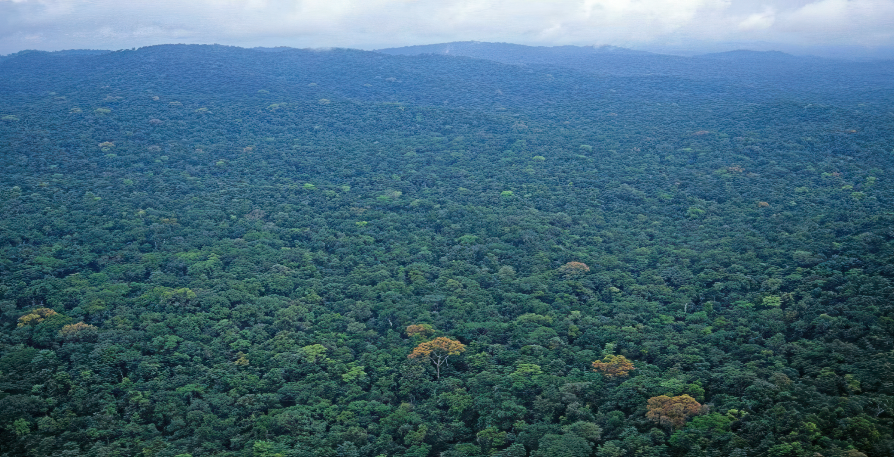
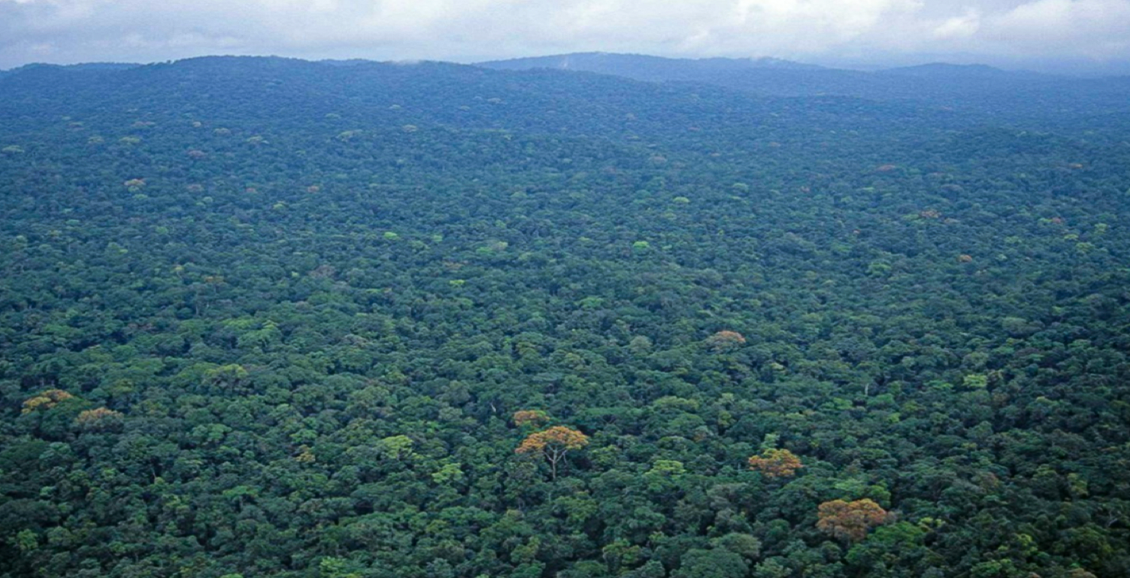


FORESTRY DEVELOPMENT AUTHORITY (FDA)
A new environment: Opportunities and Challenges
Liberia National Forest Forum November 3, 2025
Presented by:
Atty. Hon. Gertrude Wede Korvayan Nyaley
Deputy Managing Director for Commercial &
Technical Services (FDA)

Slide 2
Presentation Outline
01 | Introduction and historical context
02 | Major achievements
03 | Liberia’s vision for its forest and the sector
04 | Opportunities & Challenges in the 4C’s
05 | Developing the FDA and sector for the new environment
06 | Partnerships and stakeholders: Engaging government, private sector, communities, Donors
07 | Conclusion

Slide 3
1. Introduction and historical context
Bureau of Forests and Wildlife Conservation (1953)
1st Liberian forestry administration - the Bureau of Forests and Wildlife Conservation (1953).
Situated within the Ministry of Agriculture.
Concentrated mostly on forest inventories and concession allocation (did not have the financial freedom and flexibility necessary to supervise the sector).
Forest Development Authority (1976)
Act establishing FDA (1976) repealed all previous forestry and wildlife laws and granted the FDA the power to issue, amend and rescind forestry and wildlife regulations.
The Act -
  Defined objectives for the sector establishing a permanent forest estate (National Forests and National Parks).
  Optimized contribution of forestry to national economy-
  Increased public involvement in forest conservation and management through the creation of communal forests and agroforestry programs.
Notes:
Bureau of Forest and Wildlife.
- Established as part of an Act for conservation of the Forests of the Republic of Liberia
- It was gradually realized that the Bureau did not have the financial freedom and flexibility necessary to supervise the sector.
FDA.
- Act establishing FDA created by a Special Act on December 20, 1976. repealed all previous forestry and wildlife laws and granted the FDA the power to issue, amend and rescind forestry and wildlife regulations.

Slide 4
Timeline
1953
Establishment of Bureau of Forests and Wildlife Conservation
1976
Status changed to Forest Development Authority
2003 – 2006
UN ban on Liberian timber exports
2006
Passage of the National Forestry Reform Law that amend the NFL of 2000
The ban on timber exports lifted
Integration of the Three C in forest management
2024
Transition in government saw new management team appointed to FDA and creation of Community Conservation and Carbon Deputy and Deputy for Commercial

Slide 5
Liberia’s Vision for the Forestry Sector
“Sustainable forestry for sustainable socio-economic development.”
The FDA also aims to stop waste and destruction of forests, promote profitable harvesting of forest products, and integrate forestry with other land uses.
Manage forest and wildlife resources to meet the needs of the present and future generations.

Slide 6
The Forest Development Authority (FDA)
The FDA is mandated by law to sustainably manage and conserve the forests and related resources of Liberia for the benefit of present and future generations.
The FDA Board of Directors is highest governing body for the Institution and oversees the formulation of regulations, codes and manuals governing the forestry sector, provide strategic direction for the FDA.
Day to day oversight and management performed by the Managing Director (MD) and 3 Deputy Managing Directors (Commercial & Technical Services; Conservation, Communities & Carbon; and Finance and Administration).
The FDA regulates activities and promotes sustainable management through a "4Cs" approach (Commercial, Community, Conservation, and Carbon).
Early in 2024 with the transition in government a new management team was appointed who has expressed a clear commitment & continues to work – despite limited available resources – to rebuild sector and implement its statutory mandate.

Slide 7
FDA -Broad Responsibilities
Formulation and enforcement of forestry law, policy objectives and regulations in collaboration with the relevant and concerned ministries and agencies.
Enhancement of the sustainable management, conservation and utilization of the forest and related resources, taking into consideration their various benefits to the people and the nation.
Controlling and monitoring of concessions operations to ensure that concessionaires carry out activities in line with prescribed guidelines.
Assessment and collection of revenue from forestry activities.
Conduct of research and training
Provisions of technical assistance to operators engage in the forestry sector.
Implementation and supervision of reforestation programs and projects.
Encouraging and promoting the involvement and participation of rural dwellers in forestry programs and projects.
Protection and extension services for the sustainability of the forest estate, and
Developmental Goal; sustainable forestry for sustainable socio-economic development of Liberia.

Slide 8
2. Major Achievements
Lifting of Sanctions and resumption of timber trade.
Major contribution to national revenue and foreign earnings, year-on-year.
Building a Timber Legality Assurance System contemplated under VPA.
Development of Community Forestry: The CRL and the growing network of community forests.
Readiness for climate change and REDD+.
Expansion of the Protected Area Network and wider conservation of forest and fauna.

Slide 9
Recent Developments
Specific Examples
The FDA and communities signed an agreement to protect the East Nimba Nature Reserve.
The FDA, in collaboration with the Government of Liberia and the Liberia Chimpanzee Rescue and Protection (LCRP), provided sanctuary for chimpanzees rescued from Guinea-Bissau.
The FDA is making efforts to gazette 3 PPAs (Wonegi, Propose Kwa National Park, and Foya) by 2027.
The FDA is involved in developing a roadmap for REDD+ readiness, including a national carbon policy.
The FDA is working to implement a modern chain-of-custody system to ensure the legality of timber exports.
The FDA is actively engaged in developing a national forest management strategy.

Slide 10


Recent Developments
Specific Examples
(continues)
Liberia-EU VPA implementation
Significant contributions to Forest Sector including -
  Credible and robust Timber Legality Assurance System (one of most complex legality grids of all VPAs)
  Modern chain-of-custody system to ensure the legality of timber exports.
  Strengthened stakeholder engagement, participatory process & transparency.
  Regulatory and institutional reforms improving forest governance.
Implementing such a complex instrument not without challenges (No FLEGT licenses issued to date):
  Limited resources to effect required reforms which take time.
  Enforcement challenges with JIC resolutions and coordination gaps.
  High dependency on donor funding and limited domestic commitment.
. Long implementation period should not be interpreted as failure, but as essential element of such agreements aimed at improving and strengthening governance improvements, institutional reforms, and capacity building.
  Liberia’s experience mirrors that of other partner country such as Ghana, which took over 15 years to reach the licensing stage
Notes:
Liberia’s VPA framework is significantly more complex than those of other partner countries, both in scope and structure.
Liberia’s agreement includes 11 principles, 49 indicators, and 132 verifiers, compared to
Ghana’s 7 principles, and 22 criteria,
Guyana’s 7 principles, 12 indicators, and 12 verifiers, and
Indonesia’s 4 principles, 10 indicators, and 13 verifiers.

Slide 11
Key Challenges
1. Commercial
Undeclared felling and incomplete LiberTrace data.
Abandoned logs estimated at 60,000–75,000 m³, representing over USD 1 million in lost stumpage and export revenue.
Dormant legality verifiers, limited joint audits and inadequate resources for Commercial Annual Audits.
2. Community
Ineffective governance structures as CFMBs have overshadowed the other structures in decision-making processes.
Inadequate oversight and enforcement by FDA in the operations of Authorized Forest Communities (AFCs).
Pre-mature termination of commercial contracts by logging companies without paying liabilities to the communities.

Slide 12
Key Challenges
3. Conservation
Difficulty in balancing Conservation Objectives with Economic Development.
Policy gaps and delays in finalization has resulted to incomplete (drafts policy) while other major policies are yet to be started.
Insufficient manpower and logistics to carry out compliance monitoring making it difficult to deter illegal activities within PAs and PPAs.
4. Carbon
Liberia forest face threats such as illegal logging, agriculture expansion and unregulated mining which could undermine all gains made and hinder the country from achieving its carbon objectives
There is a need for more clarity on land tenure and how carbon rights and benefits should be allocated – national
Protection of Potential REDD+ sites such as PA are not effective due to manpower gaps and limited logistics which could lead to reduction in carbon stock.
Limited institutional capacity for fully operationalizing carbon related activities (e.g. MRV).

Slide 13
Key Challenges
5. Crosscutting
Coordination among FDA departments and partner agencies such as the EPA and Ministry of Labor is improving but remains fragmented.
Financial and operational constraints: Irregular funding and delayed disbursement continue to limit the effective participation of local communities and impede institutional operations.

Slide 14
4. Opportunities in the 4C’s
The opportunities and challenges in commercial, conservation, community and carbon forestry will be considered in detail by us all during this Forum.
Here is a taster of the priorities that we have set out to discuss with you in a series of briefing papers:

Slide 15
Commercial priorities
Strengthen Compliance and benefit sharing: e.g.reactivating legality verifiers, enhancing TLAS indicators, & publishing real-time data via a Forest Transparency Dashboard.
Regulatory Reform, strengthening institutional capacity and Improving interagency coordination: to better regulate the sector ensuring sustainable commercial forest management.
Revitalizing Inactive Concessions: through transparent audits, reallocation to compliant operators, and the enforcement of termination policies for non-performing contracts.
Expanding Domestic Processing and Value Addition: Develop an Investment Opportunity Framework to stimulate domestic processing, promote plantation rehabilitation, & expand value addition.
Promoting Sustainable Financing & Partnerships: Bilateral & Multilateral Partnerships through a Forest Governance Trust Fund, technical assistance, financing, &market access under the EU Forest Partnership & the Broader Market Recognition Collation (BMRC) & related mechanisms.
Increasing Forestry Revenue Generation: e.g. through digital tracking, automated stumpage compliance, arrears recovery, & transparent reclamation of abandoned timber.

Slide 16
Conservation priorities
Institutional Capacity Strengthening: to create a framework for managing conservation related projects.
Policy and Legal Framework: prioritize the completion of key policies and their implementation.
Interagency Coordination: reactivate the National Conservation Coordination Platform amongst EPA, FDA, LLA, and other land use related entities for joint decision making.
Community Livelihood and Stewardship: encourage partners to scale up payment for ecosystem services programs for local communities to sustain stewardship and reduce illegal activities.
Protected areas & nature-based solutions: prioritize and fast-track restoration in degraded terrestrial forests, mangroves in urban/coastal hotspots. The FDA and partners should gazette priority mangrove sites, enforce protection, and fund community-led restoration.
Conservation Finance: In collaboration with the Liberia Conservation Fund, the FDA should develop a national forest conservation finance strategy with blended finance instruments. Government should also require extractive companies to make offset payments for conservation.

Slide 17
Community priorities
Review of the legal and regulatory framework: Especially around the governance structure from CRL and LRA (CFMBs and CLDMC’s).
Revisit social agreements to ensure enforceability for community benefits: Making them more specific and binding, or re-thinking social agreements to recognise communities as owners of customary land.
Alternative sources of revenue apart from commercial logging: Climate finance, payment for ecosystem services, ecotourism, and biodiversity finance are emerging opportunities for new revenue streams to communities.
Establish a natural resource pool fund representing diverse incomes: Land and forest communities receive benefits in fragments, and the fragmented funds cannot undertake substantial projects with wider impacts. A natural resource pool fund with income from diverse sources such as mining, agricultural, land and forest can increase the amount available to communities.

Slide 18
Carbon priorities
Fully operationalize the carbon harvesting, regulation and trading department.
Finalize the National Carbon Development Policy by addressing all outstanding issues.
Collaborate with the newly formed Carbon Market Authority (CMA) to establish a National Carbon Registry.
Identify potential areas for undertaking carbon Projects.
Publish national guidelines for carbon accounting: clear methodology, leakages management rules, and permanence buffers ensure Liberia credits meet global integrity standards.

Slide 19
The New Environment
There have been major changes in the forestry sector:
Commercial logging for export has passed its peak: Revenues are not increasing, and some concessions are inactive.
New opportunities in carbon, biodiversity and community enterprises exist but are not yet providing significant economic benefits.
Most forestry activity now takes place on community land.
Deforestation is continuing and a new model for Protected Areas is required to achieve the 30% target.
The Markets for timber are now in China/Asia, not only in Europe – TLAS (VPA), BMRC, etc. ensures credibility and provides assurances to markets of Liberia timber and timber products.

Slide 20
ARREST Agenda
Key ARREST targets by 2029:
Reduce the national deforestation rate by 50%
Restore at least 10,000 ha of degraded forestlands including coastal wetlands and mangrove ecosystems.
Catalogue 100% of water catchments in forest areas.
﻿ Increase urban canopy cover in 5 cities (Paynesville, Monrovia, Buchanan, Gbarnga and Gompa) to 50%.
﻿ Strengthen and enforce forest regulations.
﻿ Plant 2,000,000 trees along major roads in six counties.
﻿ Increase the sustainable production of value-added wood products by 20%.

Slide 21
Implementing the ARREST Agenda in FDA
The Forestry Development Authority (FDA) in Liberia is undergoing several contemporary developments focused on strengthening institutional capacity, promoting sustainable forest management, and enhancing community involvement in forestry.
Institutional Strengthening
Community Forestry
Protected Areas Management
REDD+ Implementation
Sustainable Forest Management
Monitoring and Evaluation
Transparency and Accountability
Key areas of development include:
It has set out a vision for the sector and for its own development in:
A plan for internal re-organization to improve efficiency and effectiveness.
A Road Map for Liberia Forest Sector Rejuvenation.

Slide 22

Developing the FDA for the new environment
Findings from the FDA’s Institutional Development assessment:
Liberia benefits from a comprehensive legal framework & a well-developed system for timber Legality Assurance. There is need to strengthen FDAs capacity to implement this system.
FDA’s Operational effectiveness is constrained by limited funding it receives from central government.
70% of the total income to the Authority is spent on salaries, leaving inadequate resources for operations.
60% of staff are located at HQ and there is need to strengthen regional structures.
The Community Department is under-staffed & not represented in all regions.
Staff, resources and management are dispersed across a wide range of policy and project-driven activities, in addition to FDA’s legal mandate.
Cross-cutting departments and units has limited contributing value to FDA’s core functions due to coordination challenges and scarce resources.

Slide 23
Developing the FDA for the new environment: Institutional Development
Recommendations from FDA’s Institutional Development work:
Develop a sustainable financing mechanism for FDA and the Legality Assurance System.
Develop an economic strategy for the sector and for increasing revenue.
Strengthen regions, starting with the re-deployment of staff from HQ and the development of a plan for upgrading regional capacity.
Improve data and revenue collection from domestic forest trade by developing the FDA’s checkpoint monitoring.
Upgrade FDA’s Information Management System, building on Libertrace, to widen accessibility and increase public information.

Slide 24
Partnerships and Stakeholders
The Voluntary Partnership Agreement (VPA) with the EU is changing to a Forest Partnership.
International donors are cutting budgets and re-prioritising.
Communities are increasingly important stakeholders, as their ownership and rights become formalized.
New partnerships are required to commercialised carbon and other non-timber forest products at scale.

Slide 25
Cooperative governance: linking with other agencies/ regulatory services
Key Activities:
Interagency arrangements such as the IMCC, Forest Task Force (an ad hoc arrangement), and other engagement forums that provide a space for interaction and coordination between regulatory agencies on forest matters.
These agencies include mainly GoL functionaries and include the LRA, MFDP, EPA, MME, LLA, and the MoL.
The FDA’s role as the chief regulator of the forestry sector in Liberia can only be fully achieved by linking up with other key government agencies whose work impacts the forestry sector.

Slide 26
Engagement/ relationships with forest sector stakeholders
Under the VPA mechanism, there exists various engagement frameworks through which the FDA engages with stakeholders.
These mechanisms include the:
National Project Board (NPB)
National Multi-stakeholder Steering Committee Meeting (NMSCM)
Technical Liberia Implementation Committee, (LIC)
Joint Implementation Committee (JIC).

Slide 27
Conclusion
The forestry sector and the world beyond have changed dramatically.
This presents deep challenges but also great opportunities.
Liberia has strong foundations and partnerships on which to build.
We thank you for contributing your expertise and ideas at this Forum and for joining us on this journey.

Slide 28
Thank You
gwkorvayan@yahoo.com

